Slide 1
Electricity Load forecasting using machine learning
Supervised by : dr. majid jamil
Group mI 09– Affan abbasi 19bee040
Ehtesham ashraf 19bee063
Rohit pandita 19bee076

Slide 2
OBJECTIVES
To perform short term load forecasting using historical data and different neural network training algorithms on MATLAB.
To compare accuracy and error between the different prediction algorithms using different visualization graphs.
To deploy our trained and tested Neural Network Model into an Excel App to be able to perform Day-Ahead Load Forecasting.

Slide 3
optimization
Accurate and reliable forecasting techniques can contribute to:
Supply and demand planning
Strengthen the reliability of the grid.
Optimising our power system for peak times.
Integration of renewable energy sources with existing power system.

Slide 4
PROBLEM STATEMENT
System dispatchers must anticipate the system load patterns so as to have sufficient generation to satisfy the demand.
For purely thermal systems, STLF is required for Unit Commitment.
For mixed hydro-thermal system, hydro-thermal coordination is required to schedule the early operation.
STLF is also used for predictive assessment of the power system security.

Slide 5
METHODOLOGY

Slide 6
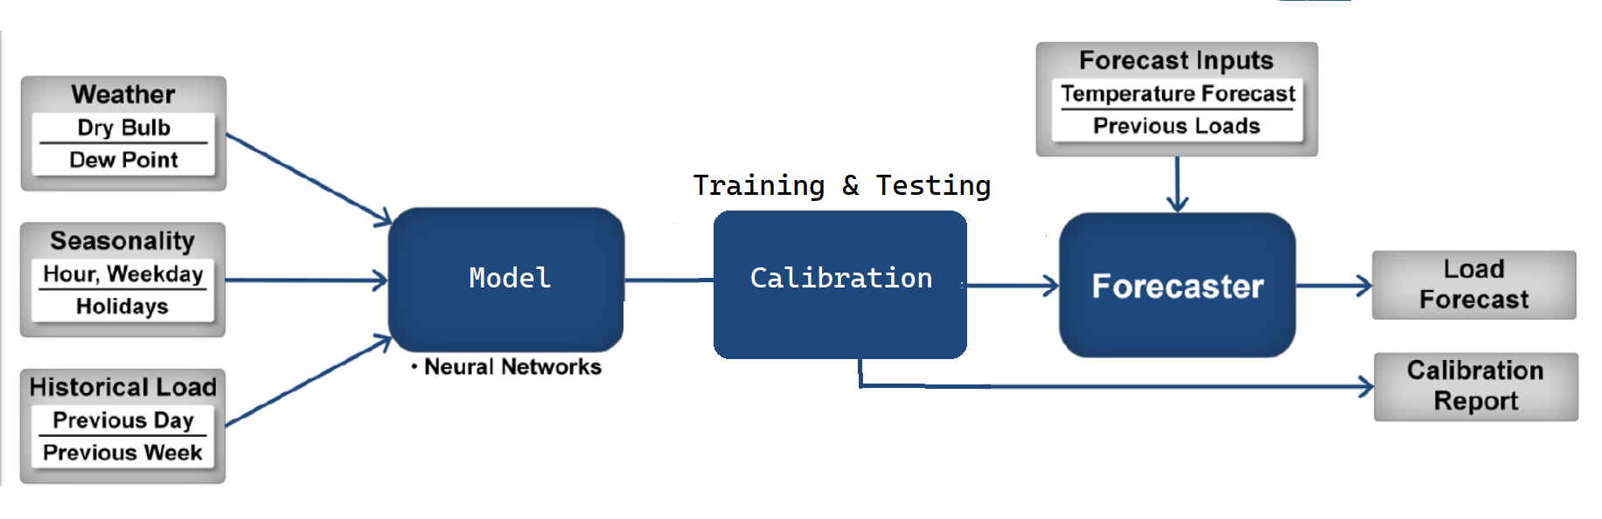
BLOCK DIAGRAM

Slide 7
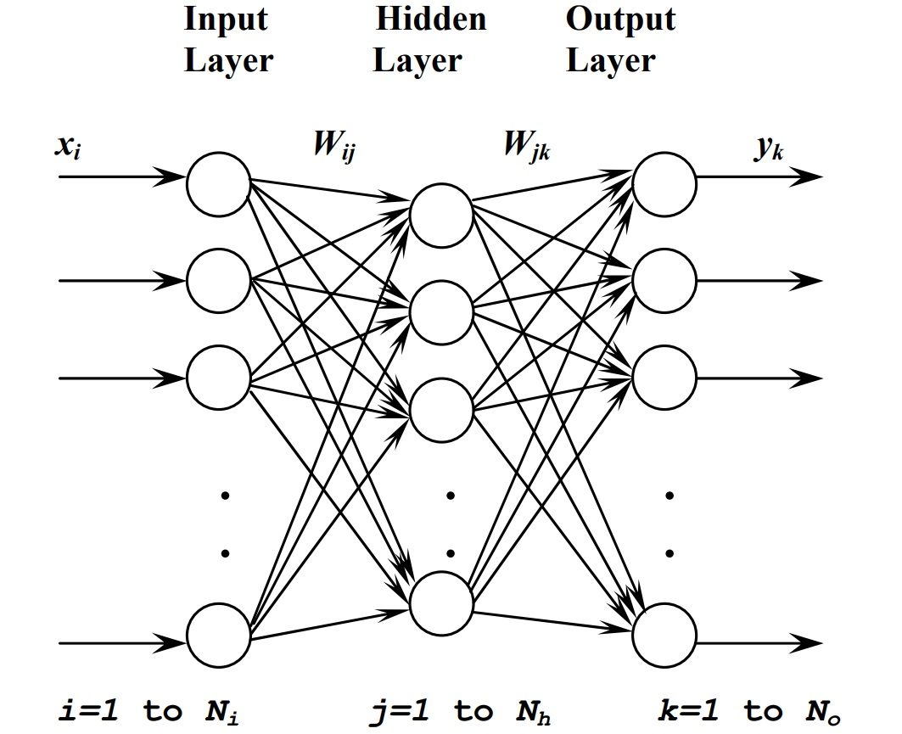
FEED-FORWARD NEURAL NETWORK[3]
The FNN is trained to approximate the nonlinear function Fs(.) between the hourly load and the input variables. The FNN comprises a layer of input units, one or more hidden layer(s) and a layer of output units. An FNN with one hidden layer is shown in Figure. The input layer consists of Ni inputs. The hidden layer in our NN model has 30 neurons.
Each ith input is connected to the each jth unit of the hidden layer by a weighting factor, Wij. Each unit in the hidden layer, called a neuron, performs a nonlinear transformation of its weighted input signals.

Slide 8
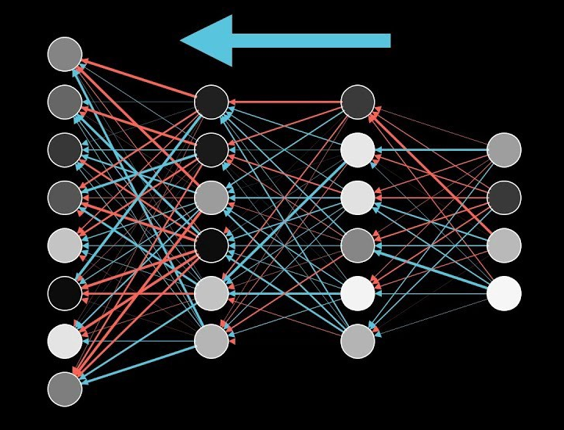
BACK PROPAGATION[4]
Back propagation is the algorithm for determining how a single training example would like to nudge the weights and biases. Not just in terms of whether they should go up or down, but in terms of what relative proportions to those changes cause the most rapid decrease to the cost.
A true gradient descent step would involve doing this for all your training examples and averaging the desired changes that you get, but that is computationally slow.
So we randomly sub divide data into mini batches and compute each step with respect to a mini batch repeatedly going through all the mini batches and making adjustments, we can converge to a local minimum of the cost function which will make the network better on training examples.

Slide 9
NEURAL NETWORK ALGORITHMS
MATLAB provides 3 training algorithms to train a Feed-Forward Neural Network.
Levenberg-Marquardt (LM) – Requires more memory but less time
Bayesian Regularization (BR) - Requires more time, but can result in good generalization for difficult, small or noisy datasets.
Scaled Conjugate Gradient (SCG) - Requires less memory

Slide 10
Levenberg-Marquardt ALGORITHM[5]
The Levenberg-Marquardt algorithm is better than Back Propagation algorithm because it has better convergence rate, the speed of iteration is more and it is more robust. The LM algorithm is very well suited for neural network training where the performance index is Mean Square Error.
It is similar to Gauss Newton Iterative Method. Only difference is if initial guess is far from the mark, the LM algorithm can still find an optimal solution.
The main problem of Levenberg-Marquardt is a selection of the hidden layer size, which is selected by hit and trial method. In some cases the LM algorithm is slow to converge this particularly happens when the parameter is more than ten.

Slide 11
Bayesian regularization ALGORITHM[6]
A regular Feed Forward Neural Network is a deterministic neural network, after training the NN, its weights will stay the same forever. That is, if we give it the same input again and again it will give us the same output.
A Bayesian NN is a non-deterministic NN. Its weights are not constant. Rather they are probability distributions. Every time the NN needs a weight, it randomly picks one up from the corresponding probability distribution. Due to this reason, it might generate different output for the same input fed into the NN.
As the weights vary, it takes more time, but is more efficient in finding the weights that minimize the cost function.

Slide 12
scaled conjugate gradient ALGORITHM[7]
The basic backpropagation algorithm adjusts the weights in the steepest descent direction (negative of the gradient). This is the direction in which the performance function is decreasing most rapidly. It turns out that, although the function decreases most rapidly along the negative of the gradient, this does not necessarily produce the fastest convergence. In the conjugate gradient algorithms a search is performed along conjugate directions, which produces generally faster convergence than steepest descent directions.
The scaled conjugate gradient (SCG) algorithm, developed by Moller [Moll93], is based on conjugate directions, but this algorithm does not perform a line search at each iteration unlike other conjugate gradient algorithms which require a line search at each iteration making the system computationally expensive. SCG was designed to avoid the time-consuming line search.

Slide 13
Implementation

Slide 14
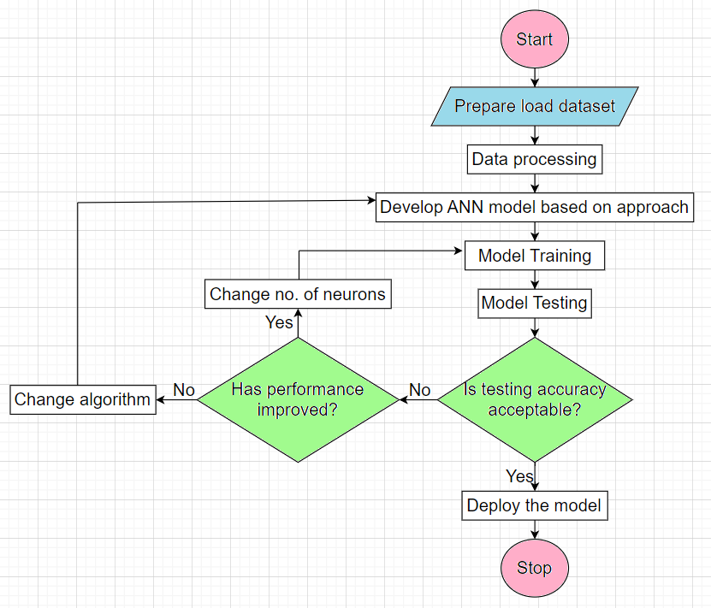

Slide 15





RAW DATA
2022
2021
2020
2019
2018

Slide 16
PREDICTOR MATRIX
Using the raw data extracted from the website, we generated a matrix with 8 parameters that would be needed to accurately predict the load forecast. These 8 parameters are:
Dry Bulb Temperature (in ºF)
Dew Point Temperature (in ºF)
Hour of Day (1 to 24)
Day of Week (1 to 7)
Working Day Indicator (0 or 1)
Previous 24-Hr Average Load
Load from the same Hour on previous Day
Load from the same Hour and same Day from previous Week.

Slide 17
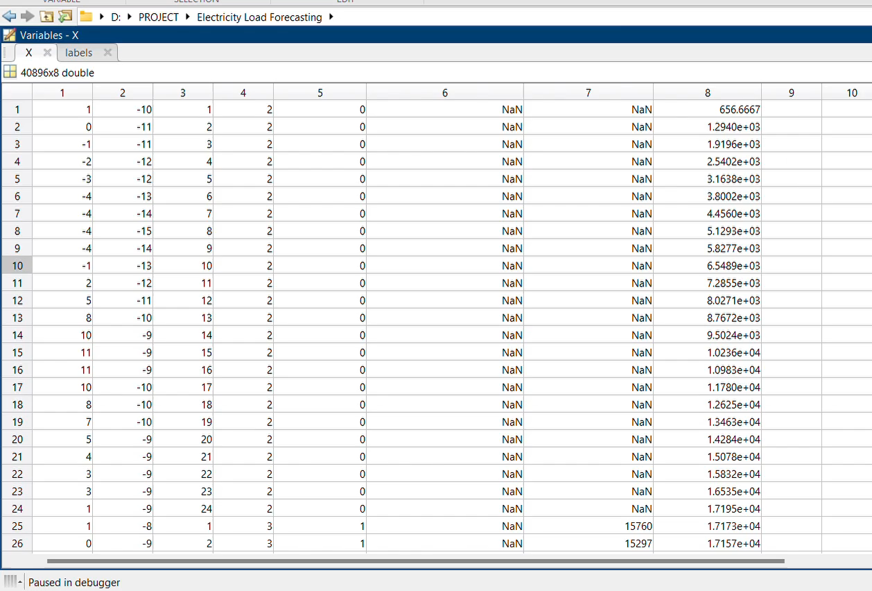
Input Predictor matrix in MATLAB (2018-2022)
DryBulb DewPoint Hour Weekday IsWorkingDay PrevWeekSameHrLoad prevDaySameHrLoad prev24HrAvgLoad

Slide 18


Functions created in MATLAB

Slide 19
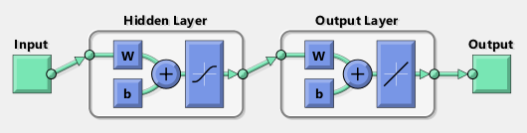
Module 1 training, testing & error analysis

Slide 20
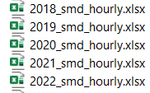
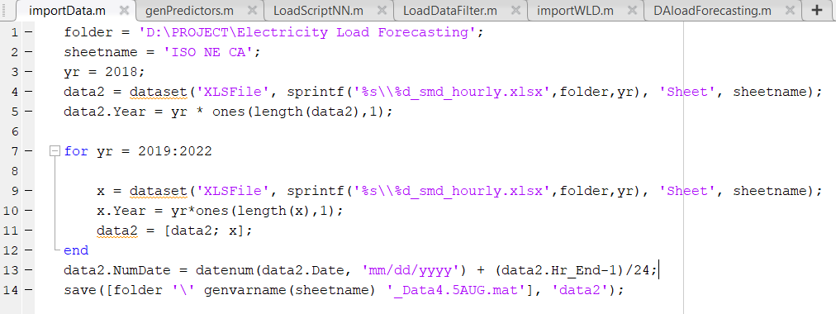
1) importData.m
To read in historical hourly load excel spreadsheets downloaded from ISO New England

Slide 21
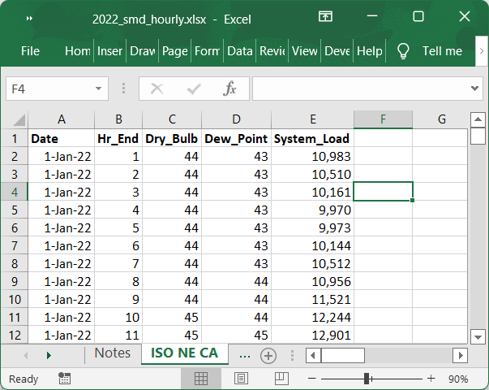
Excel spreadsheet containing historical load & temperature data from 2022

Slide 22
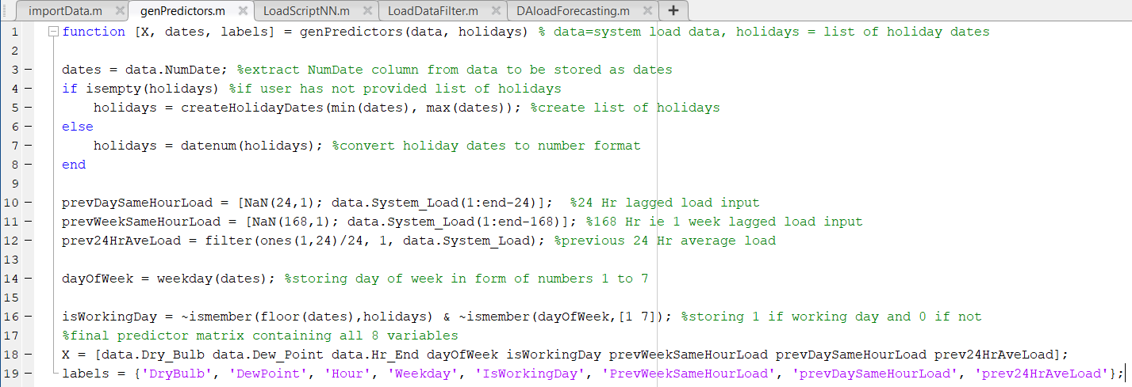
2) genPredictors.m
To generate a matrix of predictors (temperatures, day/week/holiday, etc.) for each electricity load observation

Slide 23
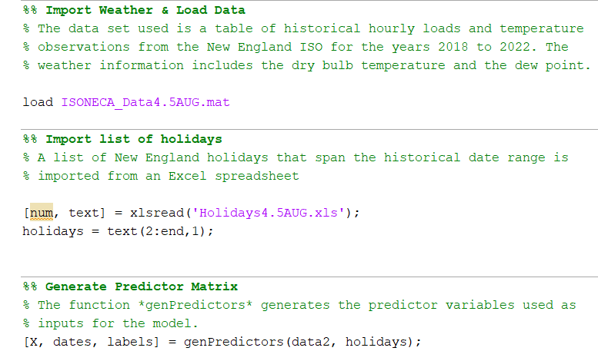
3) LoadScriptNN.m
Main function to call the rest of the functions, to train, validate and test the Neural Network, and to show the graphical error analysis.
Part I – Gather dataset and generate input predictor matrix

Slide 24
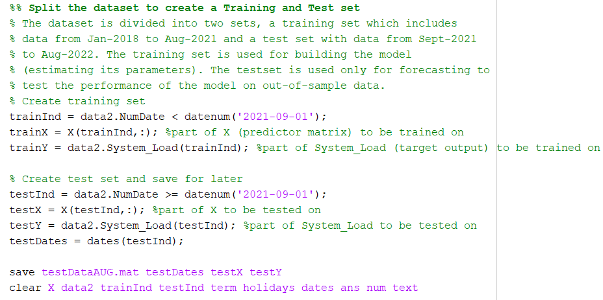
3) LoadScriptNN.m
Part II – Split dataset to create Training set and Test set

Slide 25
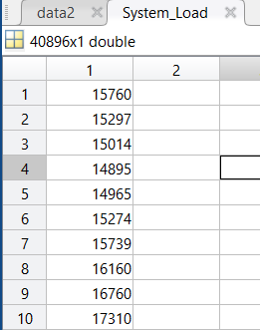
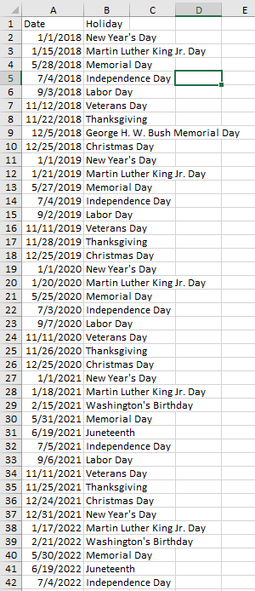
Excel file having list of holidays from 2018-2022
Target matrix having system load data for 2018-2022

Slide 26
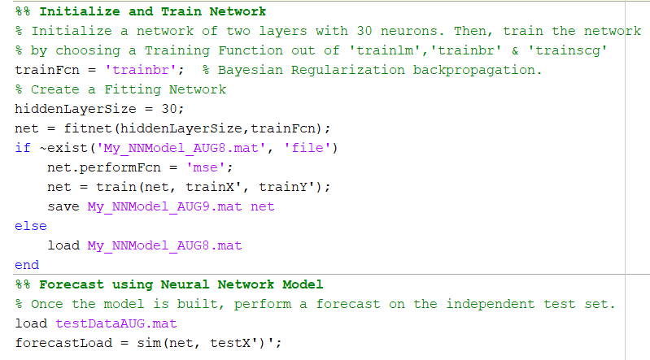
3) LoadScriptNN.m
Part III – Perform training and testing to build the load forecasting model

Slide 27
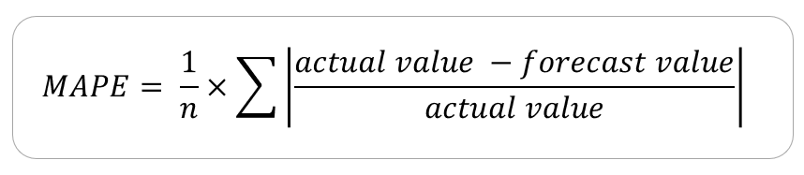
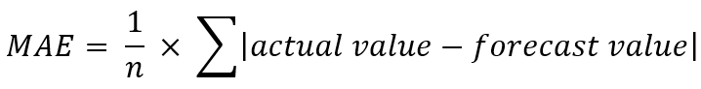
Formula for calculating error
MAPE = Mean Absolute Percentage Error
MAE = Mean Absolute Error
n = No. of data values

Slide 28
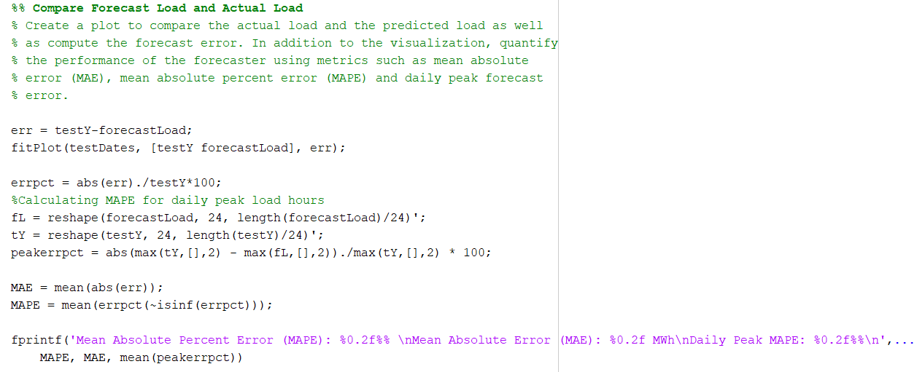
3) LoadScriptNN.m
Part IV – Perform Error Analysis on testing results

Slide 29
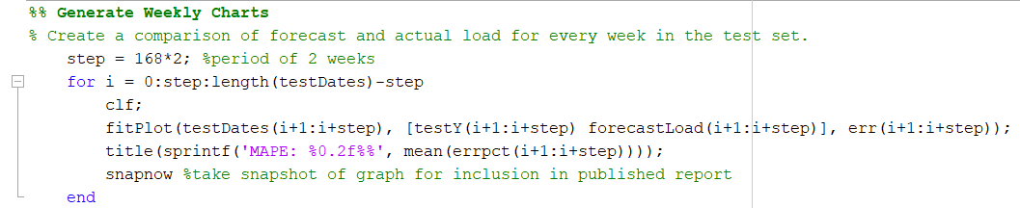
3) LoadScriptNN.m
Part IV – Perform Error Analysis on testing results (contd.)

Slide 30

Graphical error comparison b/w 3 algorithms

Slide 31
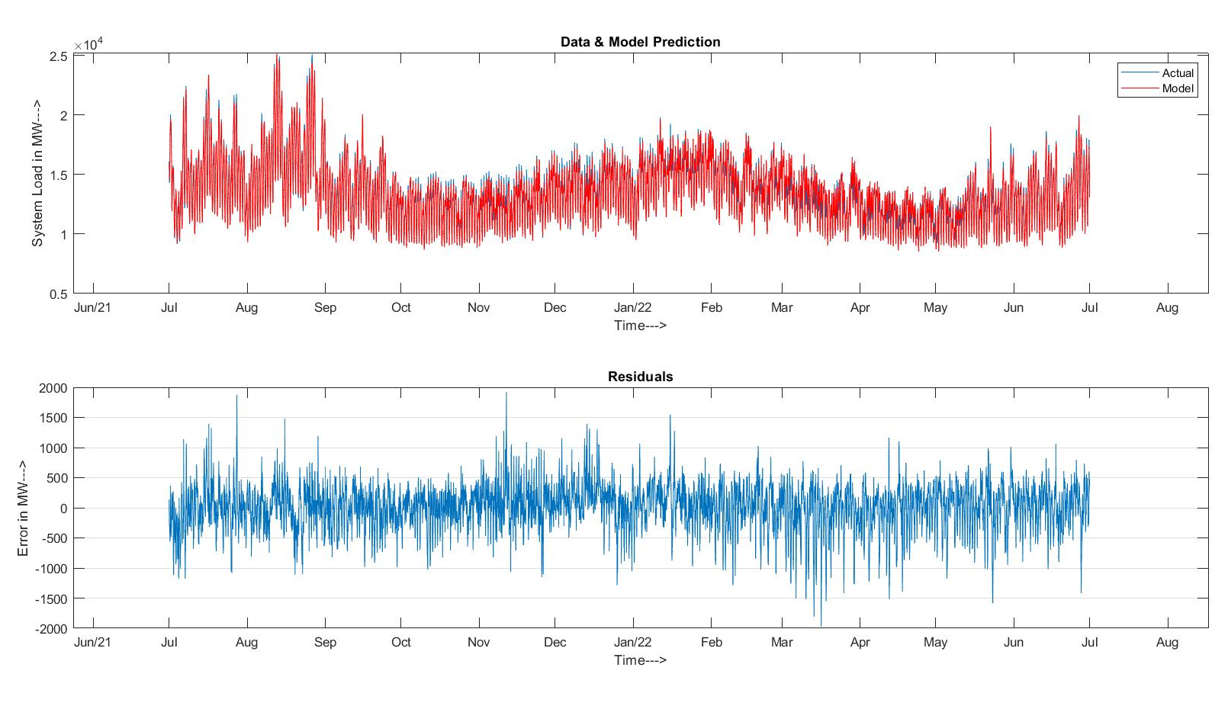
Using Levenberg-Marquardt algorithm
Mean Absolute Percent Error (MAPE): 2.14%
Mean Absolute Error (MAE): 285.70 MW
Daily Peak MAPE: 1.97%

Slide 32
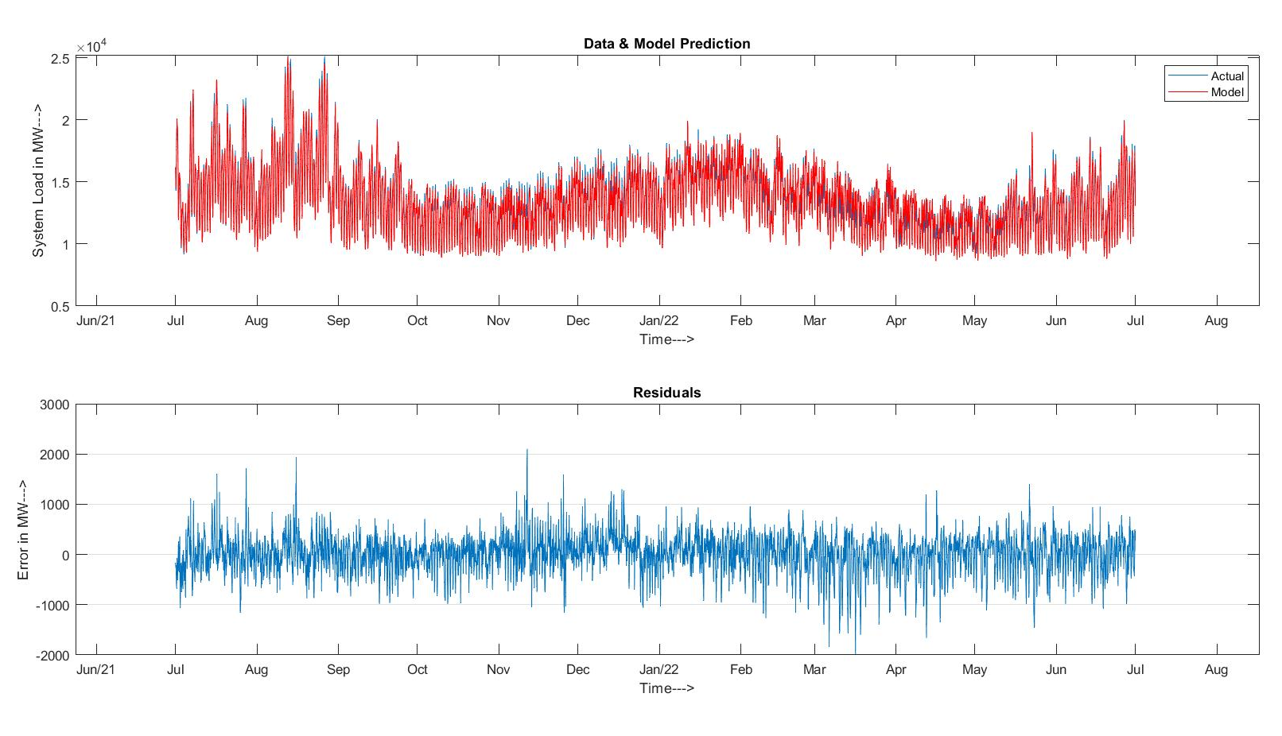
Using Bayesian Regularization algorithm
Levenberg-Marquardt (LM)
Mean Absolute Percent Error (MAPE): 2.10%
Mean Absolute Error (MAE): 280.69 MW
Daily Peak MAPE: 1.93%

Slide 33
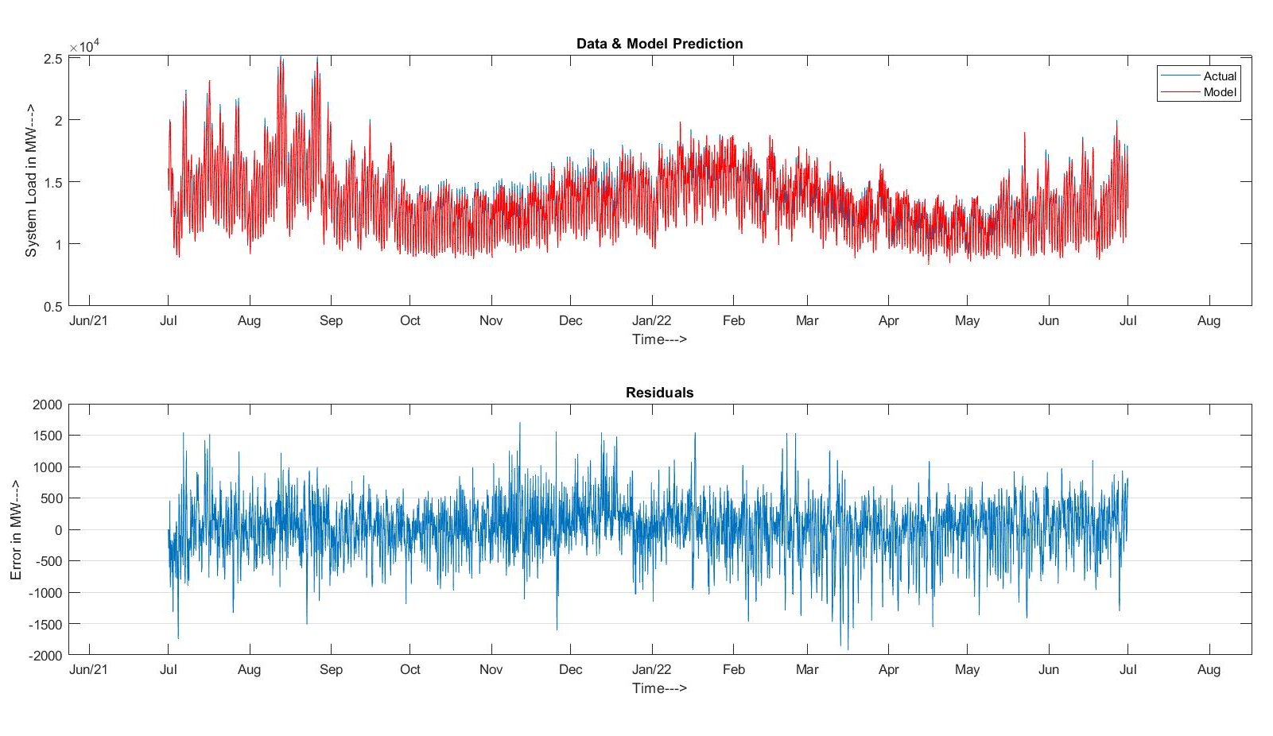
Using Scaled Conjugate Gradient algorithm
Levenberg-Marquardt (LM)
Mean Absolute Percent Error (MAPE): 2.32%
Mean Absolute Error (MAE): 310.19 MW
Daily Peak MAPE: 2.21%

Slide 34


Module 2 deploy nn model in excel app

Slide 35
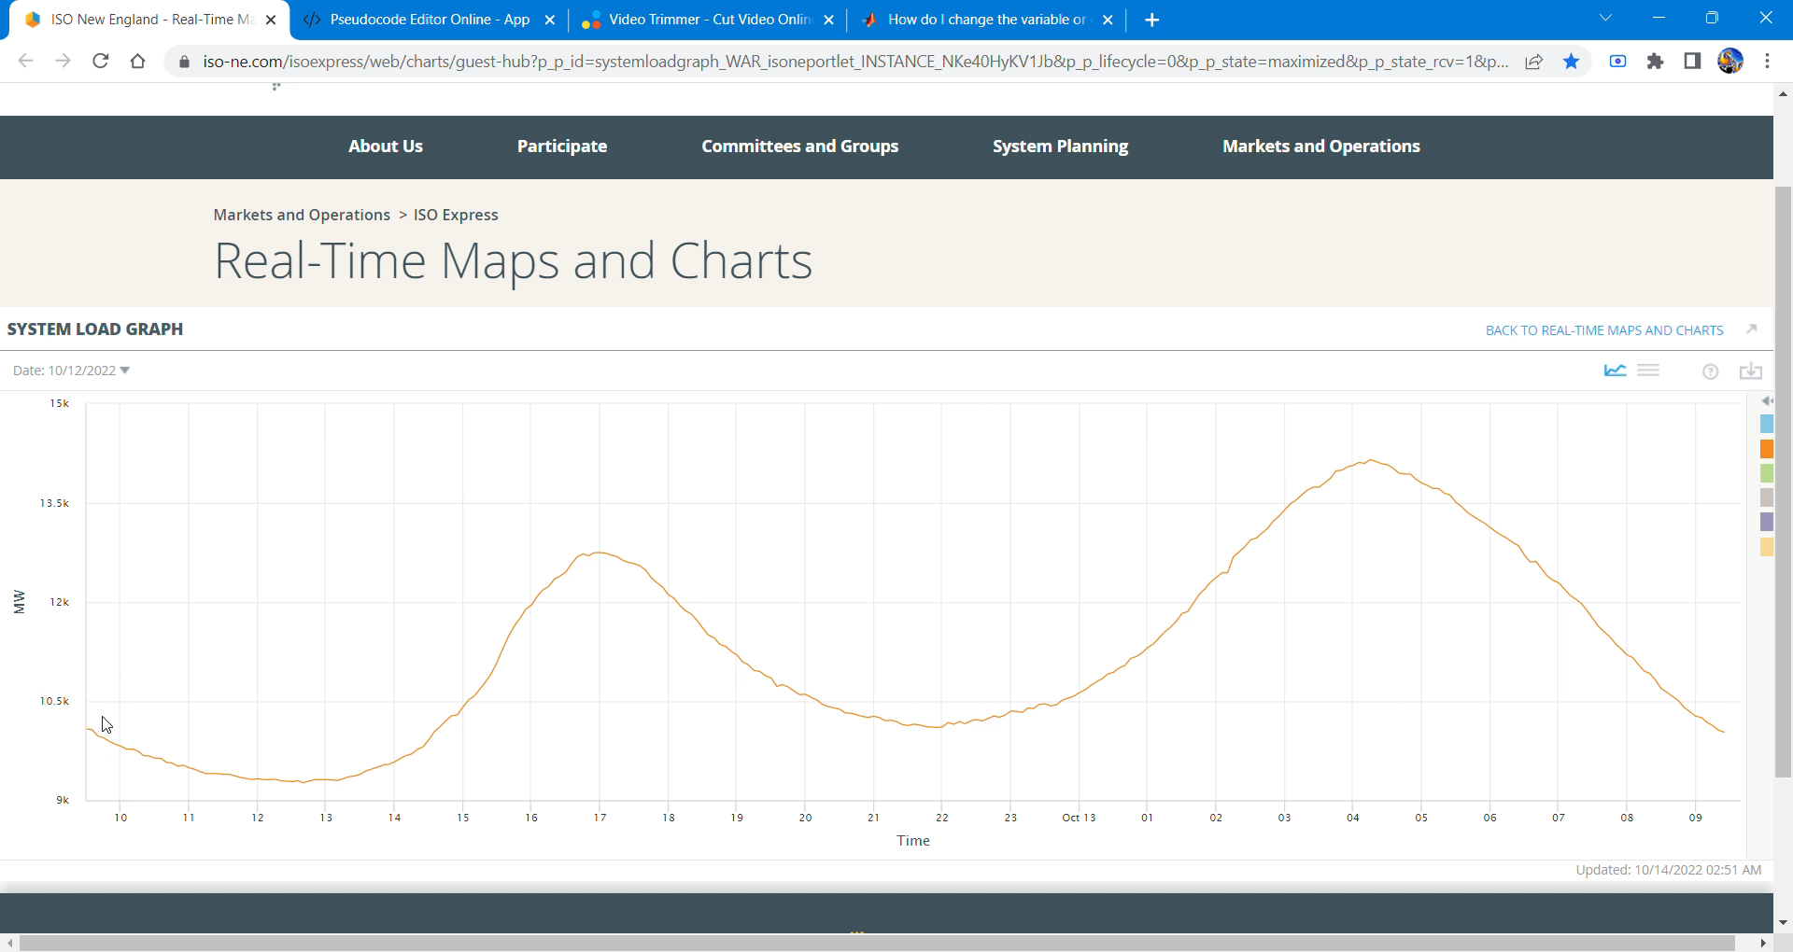
4) LoadDataFilter.m
To filter and time-shift the load curve data acquired from ISO New England website and save it in a .mat file

Slide 36
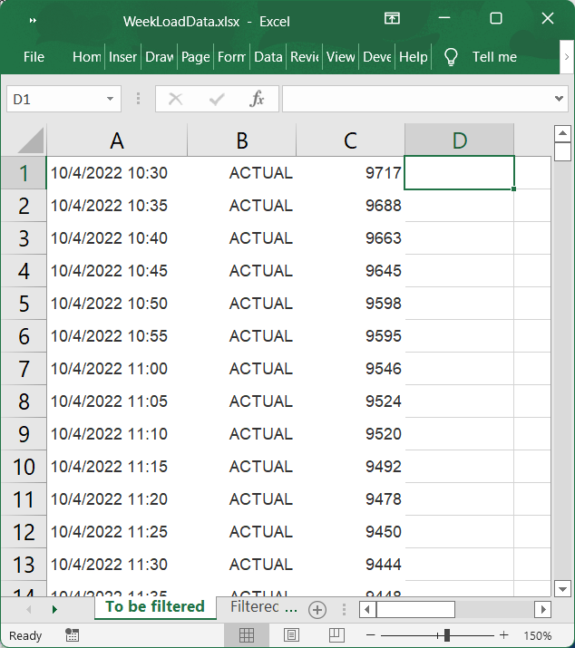
Load data To be filtered (2005 rows)

Slide 37
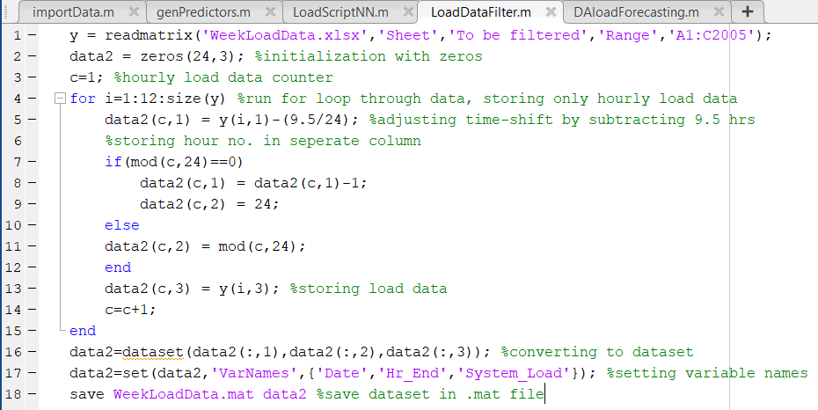
4) LoadDataFilter.m (Contd.)
To filter and time-shift the load curve data acquired from ISO New England website and save it in a .mat file

Slide 38
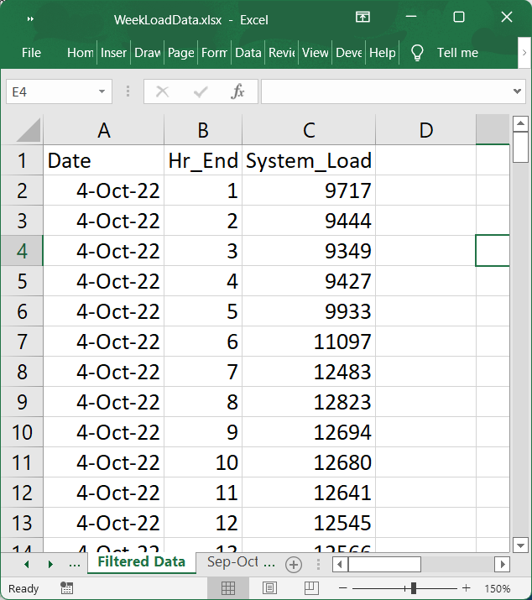
Filtered load data (168 rows)

Slide 39
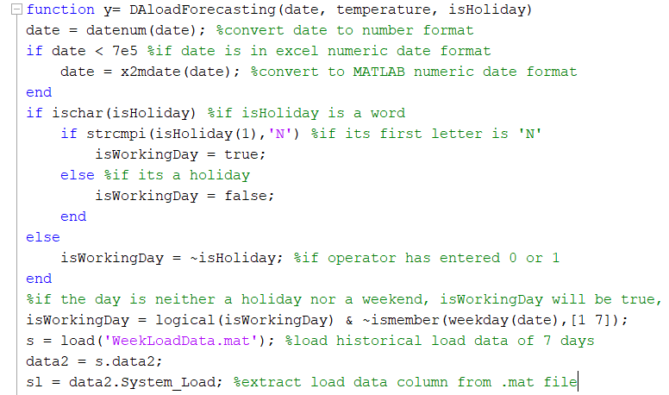
5) DAloadForecasting.m – Part I
To predict the load forecast for the next day using its date, temperature forecast, historical load data from a week prior and a holiday indicator.

Slide 40
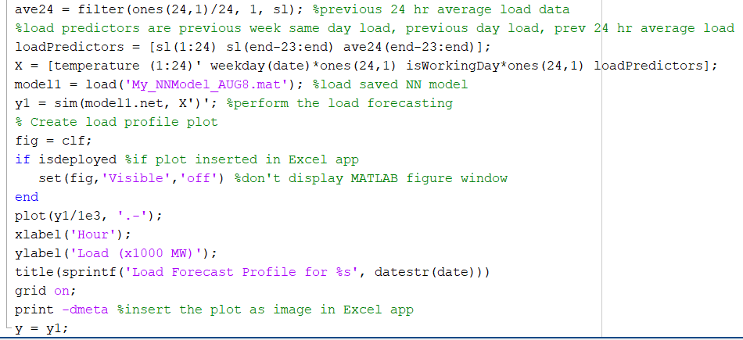
5) DAloadForecasting.m – Part II
To predict the load forecast for the next day using its date, temperature forecast, historical load data from a week prior and a holiday indicator.

Slide 41
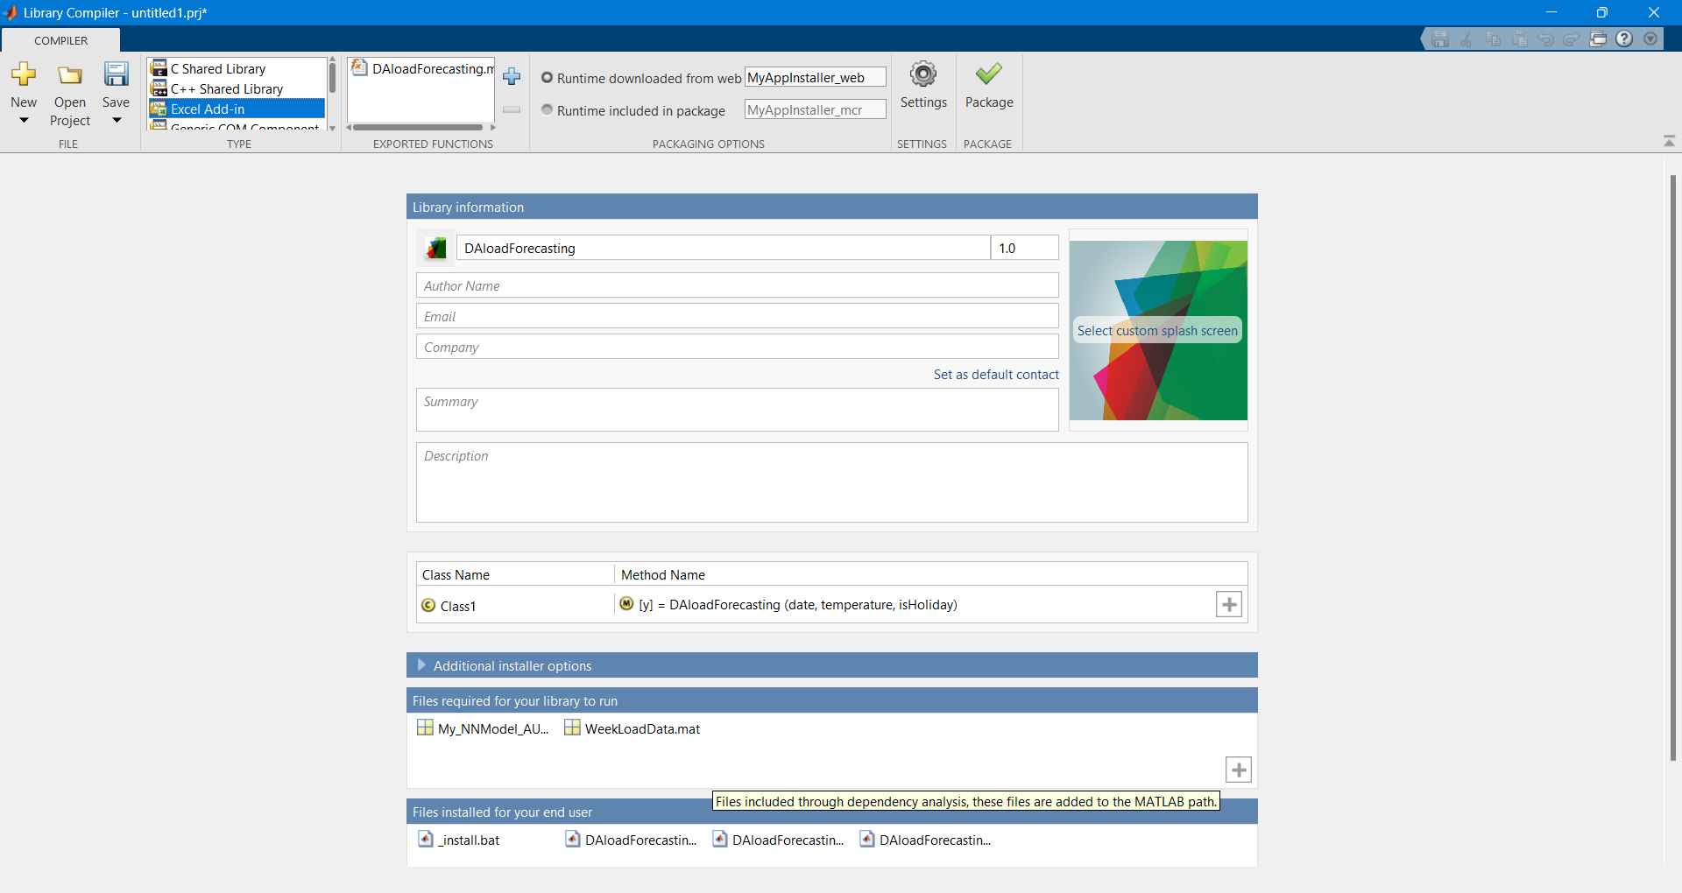
5) DAloadForecasting.m (contd.)
Using the Library Compiler App in MATLAB, we package the DAloadForecasting function for deployment as an Excel Add-in, and save the generated files.

Slide 42

5) DAloadForecasting.m (contd.)
This Macro-Enabled Excel file can be used by an operator to predict the load forecast just by providing temperature forecast and then clicking the compute forecast button.

Slide 43
Conclusion
Load Forecasting results always contain certain degree of error. This error is due to the random nature of the load and human behavior.
The Bayesian Regularization Algorithm gave the best accuracy in predicting the load forecast among the 3 algorithms compared.
The day ahead forecasting is performed using an application made in Excel which requires input of load data of the previous week, temperature and date of the day on which load needs to be forecasted.
For designing a load forecaster, forecasting time and weather of the location have significant effect on the accuracy.

Slide 44
REFERENCES
[1] G. Gross and F. D. Galiana, "Short-term load forecasting," in Proceedings of the IEEE, vol. 75, no. 12, pp. 1558-1573, Dec. 1987, doi: 10.1109/PROC.1987.13927.
[2] M. S. Thomas and J. D. McDonald, Power System SCADA and Smart Grids, Boca Raton, Florida, USA: CRC PRESS, 2015.
[3] S. Sharif and J. H. Taylor, “Short-Term Load Forecasting by Feed-forward Neural Networks”, Proc. IEEE/ASME First International Energy Conference (IEC 2000), Al Ain, United Arab Emirates.
[4] “Chapter 4 What is backpropagation really doing?” ,Published Nov 3, 2017,Lesson by Grant Sanderson, text adaptation by Josh Pullen
[5] “Levenberg–Marquardt Algorithm - Wikipedia.” Levenberg–Marquardt Algorithm - Wikipedia, en.wikipedia.org/wiki/Levenberg%E2%80%93Marquardt_algorithm. Accessed 10 Oct. 2022.
[6] Lalit Mohan Saini ,”Peak load forecasting using Bayesian regularization, Resilient and adaptive backpropagation learning based artificial neural networks” , Electric Power Systems Research 78 (2008) 1302–1310
[7] Lalit Mohan Saini and Mahender Kumar Soni, “Artificial Neural Network-Based Peak Load Forecasting Using Conjugate Gradient Methods”, IEEE TRANSACTIONS ON POWER SYSTEMS, VOL. 17, NO. 3, AUGUST 2002
[8] MATLAB. (R2021.a). Mathworks.

Slide 45
THANK YOU

